Slide 1
Geodesics on Tensor Product Surfaces
Bethany Witemeyer
Geometric Modeling
December 15, 2021

Slide 2
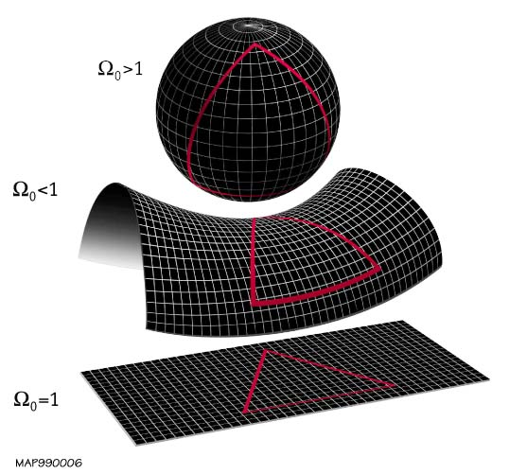
What is a Geodesic?
A shortest path on a surface
Typically found using a differential equation on continuous surfaces
Public Domain, https://commons.wikimedia.org/w/index.php?curid=647033

Slide 3

The Goal
Geodesics have many applications, but are hard to calculate
Calculate geodesics on tensor product surfaces
  $\sum_{i=0}^{m}{\sum_{j=0}^{n}{c_{i,j}f_{i}(u)g_{j}(v)}}$
Calculate approximate geodesics by discretizing the path and using the straight-line distance
Minimize the length of the path by moving the (u,v) coordinates of the intermediate points

Slide 4
Attempt One

Slide 5
The solution
Subdivide the path segments
Don’t add the new points to the optimization problem
Forces the path to be closer to the actual surface distance

Slide 6
Attempt Two

Slide 7
Conclusions
We can calculate approximate geodesics on a tensor product surface!
Reparameterize the path using arc length
Use machine learning to speed up the calculation
Compare other ways of calculating geodesics

